Slide 1
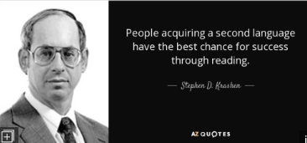

Slide 3
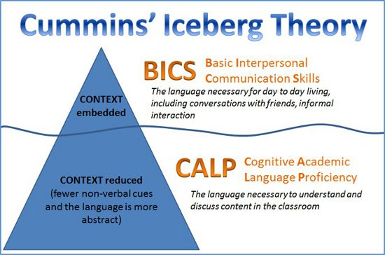

Slide 5
Why Is English So Hard?
Is it good if a vacuum really sucks?
Why do we drive on a parkway and park in a driveway?
Why are a “wise man” and a “wise guy” opposites?
The farm was used to produce produce.
The bandage was wound around the wound.
Upon seeing the tear in the painting, I shed a tear.

Slide 7
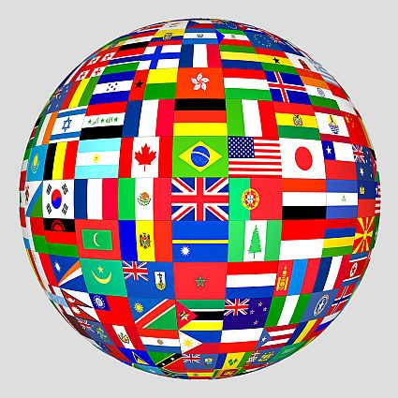

Slide 8
